Slide 1
AI-Powered Personal Farming Assistant
PRESENTED BY
GUIDED BY
POOMATHI T[922523106150]
Mr. MOHAMMED YOUNUS
SANDHIYA S[922523106181]
Department of ECE
V.S.B Engineering college, Karur
SARUPRABHA K[922523106189]
FIRST REVIEW - V.S.B ENGINEERING COLLEGE , KARUR

Slide 2
OBJECTIVE
Develop an AI-based smart farming assistant
Detect plant diseases early using image processing
Provide real-time weather updates for better planning
Suggest fertilizers and pesticides automatically
Increase crop yield and reduce losses
Make the system simple and user-friendly for farmers
FIRST REVIEW - V.S.B ENGINEERING COLLEGE , KARUR

Slide 3
INTRODUCTION
Agriculture is a major part of our country’s economy and many people depend on farming.
Farmers face real problems like:
Identifying plant diseases
Weather uncertainty
Lack of expert advice
In our project demo, we show how a farmer can use a simple app to solve these problems.
This system uses Artificial Intelligence to analyze crop images and provide instant results.
It acts like a personal assistant for farmers.
FIRST REVIEW - V.S.B ENGINEERING COLLEGE , KARUR

Slide 4
PROPOSED METHODOLOGY
User Interface: User opens the application and selects a feature (Disease Detection / Weather / Chatbot)
Image Input: User uploads plant leaf image for disease detection
Data Processing: Image is sent to backend → AI model analyzes the image
Result Output: System displays disease name and suggested solution
Weather Module: User location is taken → Weather API provides real-time data
Chat Assistant: Chatbot answers farmer queries and provides guidance
Final Output: All results are shown clearly in the application
FIRST REVIEW - V.S.B ENGINEERING COLLEGE , KARUR

Slide 5
TECHNICAL APPROACH
Frontend: HTML, CSS, JavaScript
Backend: Python / Node.js
AI Model: CNN (Deep Learning Model)
Image Processing: OpenCV
Weather API: Provides real-time weather data
Database: MySQL / Firebase
Development Tool: VS Cod
.
FIRST REVIEW - V.S.B ENGINEERING COLLEGE , KARUR

Slide 6
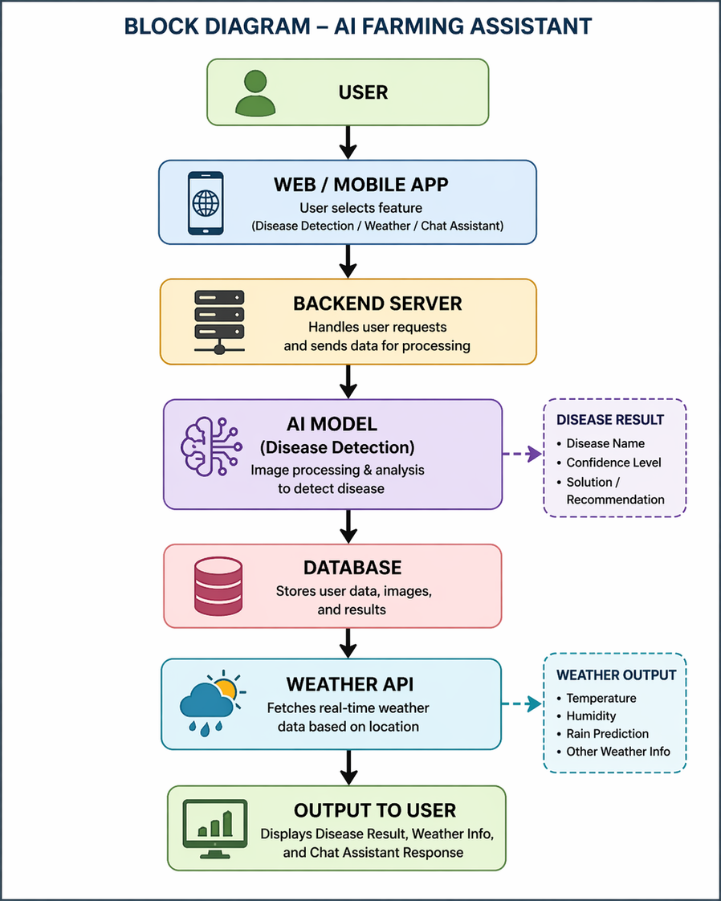
BLOCK DIAGRAM
.
FIRST REVIEW - V.S.B ENGINEERING COLLEGE , KARUR

Slide 7
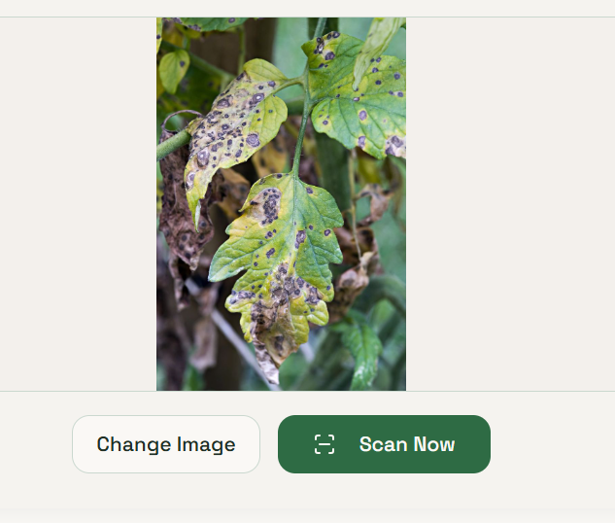
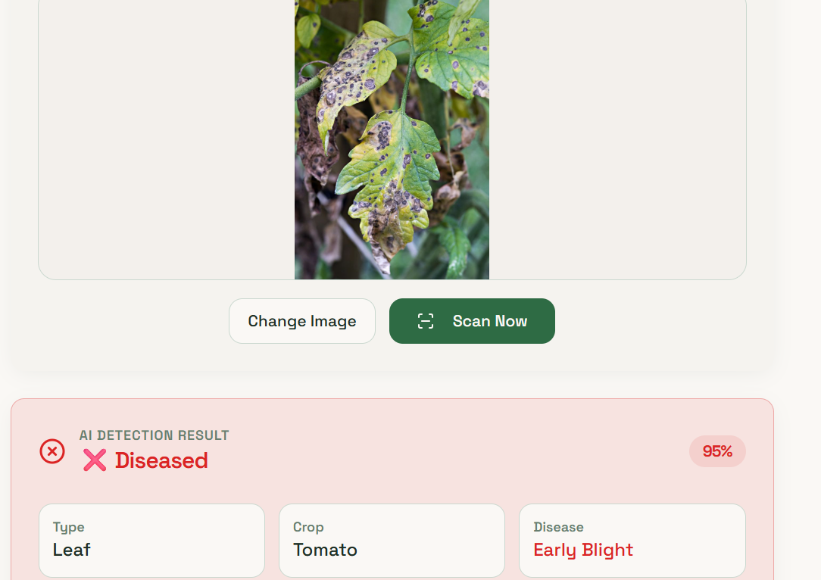
INPUT AND OUTPUT FORMAT
INPUT
OUTPUT
FIRST REVIEW - V.S.B ENGINEERING COLLEGE , KARUR

Slide 8
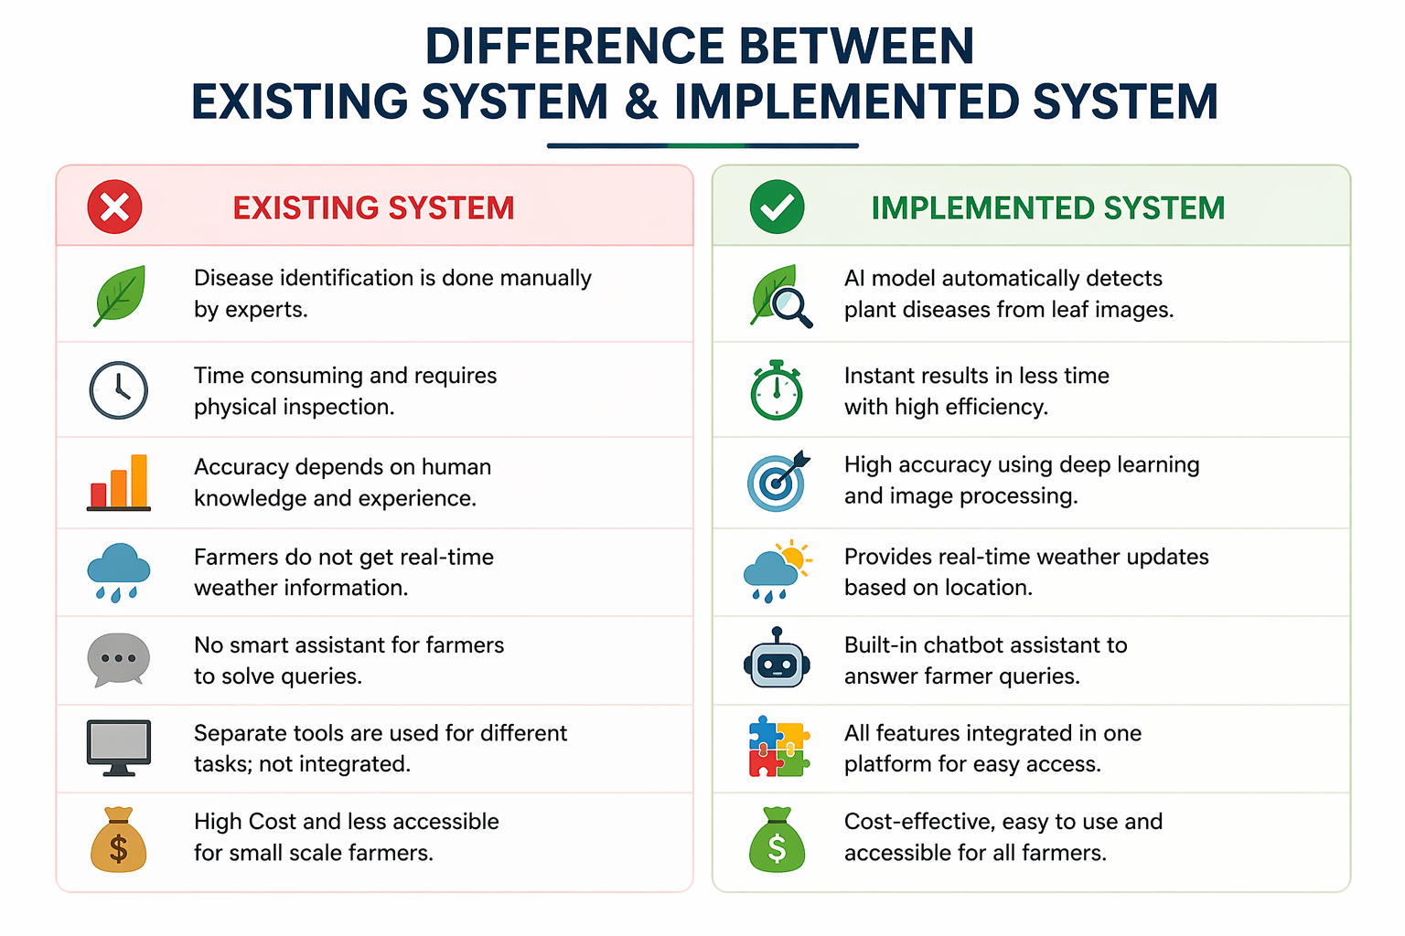
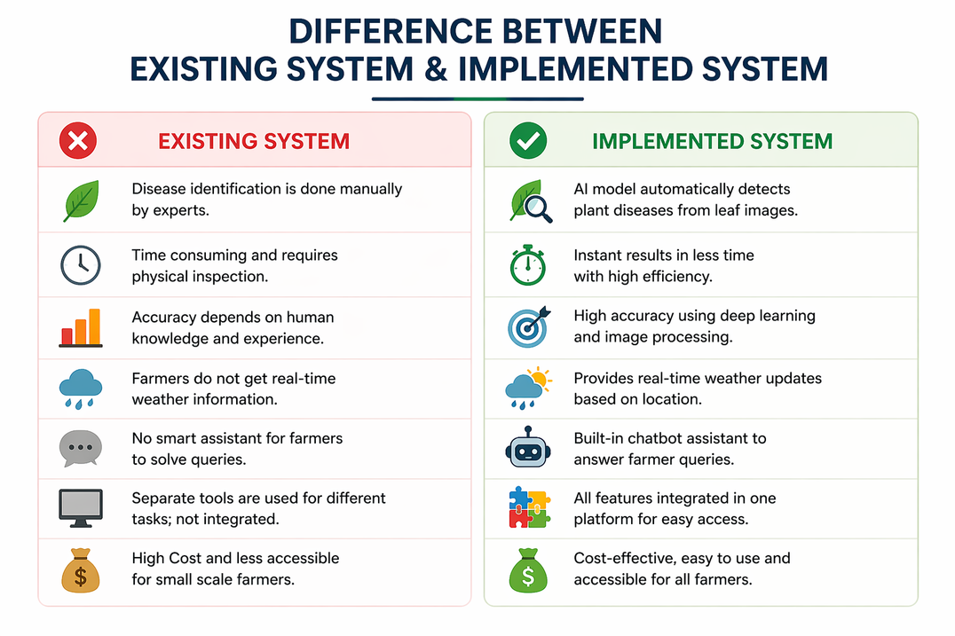
FIRST REVIEW - V.S.B ENGINEERING COLLEGE , KARUR

Slide 9
COMPLETE DESCRIPTION
AI-based application to help farmers in daily activities
Provides three main features:
* Disease detection using plant image
* Real-time weather updates
* Chat assistant for queries
Uses AI, image processing, and APIs
Backend processes data and generates results
Results are shown clearly in the app
Helps farmers take quick and correct decisions
Reduces need for expert support
FIRST REVIEW - V.S.B ENGINEERING COLLEGE , KARUR

Slide 10
FEASIBILITY AND VIABILITY
Technical Feasibility:
Uses available AI tools, APIs, and web technologies
Economic Feasibility:
Low development cost and affordable for farmers
Operational Feasibility:
Easy to use with simple interface
Time Feasibility:
Can be developed and deployed quickly
Scalability:
Can be expanded with more features in future
FIRST REVIEW - V.S.B ENGINEERING COLLEGE , KARUR

Slide 11
IMPACT AND BENEFITS
Improves farming by providing quick and accurate decisions
Helps in early detection of plant diseases, reducing crop loss
Provides real-time weather updates for better planning
Saves time and cost for farmers
Reduces dependency on agricultural experts
Supports smart and modern farming practices
FIRST REVIEW - V.S.B ENGINEERING COLLEGE , KARUR

Slide 12
LITERATURE REVIEW
THEME
Publication
Development of smart agricultural systems integrating weather forecasting, IoT, and decision-support tools for farmers
Agricultural Technology Reports and Research Papers (2019–2023)
Application of chatbot systems and AI assistants to provide real-time guidance and support to farmers
AI and Smart Farming Research Articles (2021–2024)
Use of Artificial Intelligence in agriculture for improving crop health and productivity through image-based disease detection and smart farming techniques
Research Papers, Journals, and IEEE/Elsevier Studies (2020–2024)
FIRST REVIEW - V.S.B ENGINEERING COLLEGE , KARUR

Slide 13
Thankyou
FIRST REVIEW - V.S.B ENGINEERING COLLEGE , KARUR

